Slide 1

University Institute of Liberal Arts and Humanities
Course Name: Communication Skills
Course Code: 23PCH-105
PARAGRAPH WRITING
DISCOVER . LEARN . EMPOWER

Slide 2
COURSE OBJECTIVES
The Course aims to:
1 | Augment students overall communication and interpersonal skills by making them realize the importance of good oral and written English Language in professional life.
2 | Enrich their reading capability with special emphasis on expanding vocabulary and grammatical formations.
3 | Build exceptional speaking, reading and writing skills by correcting grammatical errors and pronunciation through practice.
4 | Enhances soft skills by fostering self awareness, confidence and a positive attitude in students’ ability to communicate effectively in English.

Slide 3


COURSE OUTCOMES
Space for visual (size 24)
On completion, the students are expected to
CO Number | Title | Level
CO1 | Apply appropriate Listening, Speaking, Reading and Writing Skills (LSRW Skills) with correct non-verbal cues to attain expertise in soft skills. | Apply
CO2 | Apply correct contextual and comprehensible written text in the form of paragraph writing, short compositions business correspondence, using logical support and argument in a wide range of communication situations. | Apply
CO3 | Demonstrate linguistic competence while speaking and during presentations through accuracy in grammatical usage, vocabulary, pronunciation and intonation. | Apply
CO4 | Evaluate information as critical readers, speakers and writers applying ethics in communication and being sensitive in cross cultural communication. | Evaluate
CO5 | Create original, digital content for websites, blogs, vlogs and personal social media profiles etc. | Create
www.jrousseaux1984.com

Slide 4
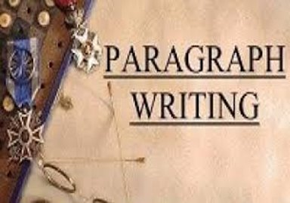
WHAT IS A PARAGRAPH?
It is a series of sentences which are related to a topic or an idea.
These sentences are coherent, organized and develop the main topic or idea.
A paragraph is usually 5 to 10 sentences long or a half page.
www.authorstream.com

Slide 5
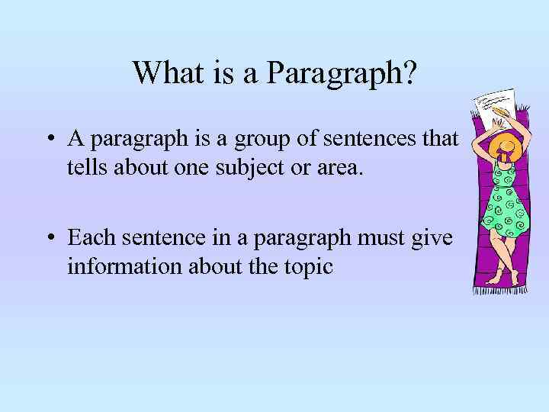
A PARAGRAPH
Is a part of longer composition, like a miniature essay.
Shows well organized content.
Has a thematic unity.
www.present5.com

Slide 6
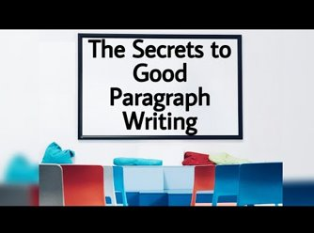
COMPONENTS OF A PARAGRAPH
The Topic sentence
Supporting details
Closing sentence
i.ytimg.com

Slide 7
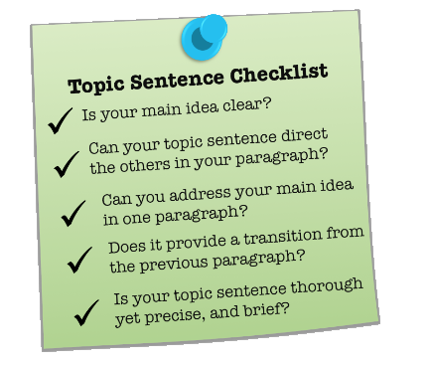
THE TOPIC SENTENCE
It is the introductory sentence.
It has the controlling idea and tells the reader what the paragraph is about.
It must be a complete sentence.
www.kibin.com

Slide 8
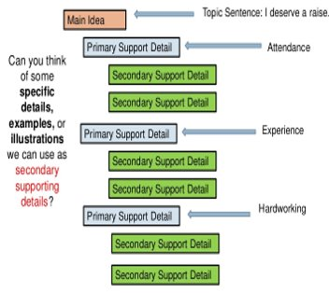
SUPPORTING DETAILS
They provide information to support the topic sentence.
It can be a definition, explanation or an example.
image.slidesharecdn.com

Slide 9
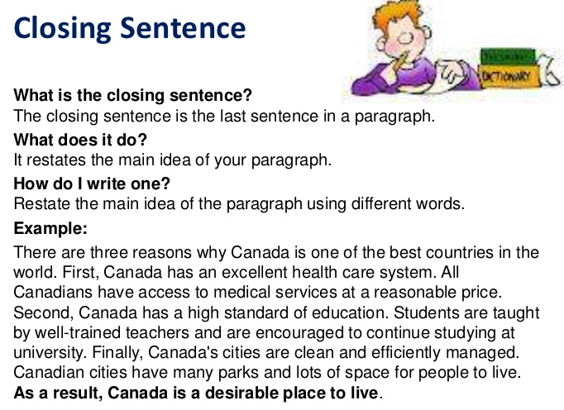
CLOSING SENTENCE
It is the concluding sentence which summarizes the main idea and feeling of the paragraph.
www.slideshare.net

Slide 10
POLL QUESTION 1
Which of these is true for a topic sentence?
A topic sentence can be incomplete.
Everything in the paragraph is tied back to the topic sentence
A topic sentence can never be a question.
A topic sentence and closing sentence are the same.

Slide 11
ESSENTIAL ELEMENTS
There are 4 fundamental elements which make an effective paragraph. These are as follows:
UNITY
COHERENCE
ORDER
COMPLETENESS

Slide 12
UNITY
Unity in a paragraph begins with the topic sentence which describes the central idea of the paragraph.
A paragraph has unity when all the supporting sentences support the central idea, that means sentences are unified to the topic.
It means oneness, that is the entire paragraph should focus on one single idea.
This way thematic unity is developed.

Slide 13
COHERENCE
Coherence means maintaining the logical glue in the paragraph.
The supporting sentences are in logical order.
This order is created by using appropriate transition words.
The logical flow is created in the paragraph when one idea leads to the another.
Paragraph becomes comprehensible.

Slide 14
POLL QUESTION 2
What do you think of the word COHERENCE?
Hold together
No sudden jumps and each sentence should flow smoothly into the next one.
The movement from one sentence to the next must be logical and smooth.
All of the above.

Slide 15
ORDER
It is achieved by systemizing the supporting sentences.
The sentences in the paragraph should be put in a particular order, for example, a sequential order, while sustaining the idea.
Develops well organized content.
Organized sentences clears the central idea to the reader.

Slide 16
COMPLETENESS
A complete paragraph provides complete information and states clearly the central idea.
Information is provided with the use of examples, details and answering the possible WH questions.
A complete well-developed paragraph has the topic sentence which is followed by at least three supporting sentences and a closing sentence.
The closing sentence reinforces the topic sentence.

Slide 17
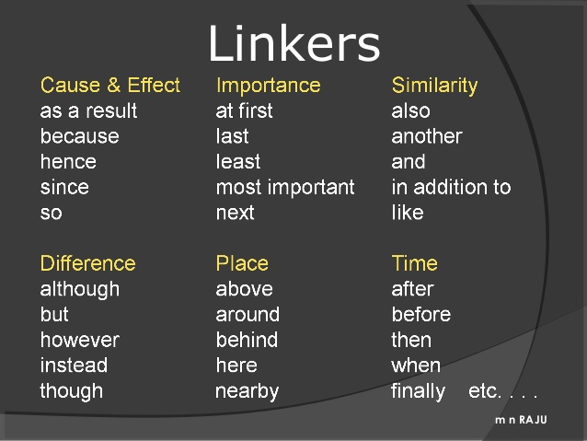
TRANSITION WORDS
image.slidesharecdn.com

Slide 18
POLL QUESTION 3
Why do we need to learn unity and coherence techniques?
To increase words during the process of writing an essay.
To make paragraphs logical and clear with certain topics.
To show your vocabulary and language skills.
To attract your reader’s attention.

Slide 19
SAMPLE
Canada is one of the best countries in the world to live in. First, Canada has an excellent health care system. All Canadians have access to medical services at a reasonable price. Second, Canada has a high standard of education. Students are taught by well‐trained teachers and are encouraged to continue studying at university. Finally, Canada's cities are clean and efficiently managed. Canadian cities have many parks and lots of space for people to live. As a result, Canada is a desirable place to live.
THE TOPIC SENTENCE SUPPORTING DETAILS CLOSING SENTENCE

Slide 20
QUIZ
TRUE OR FALSE?
A paragraph always contains one main idea.
The main idea is reflected in the topic.
The topic sentence is developed into a paragraph.
Besides the topic sentence, a paragraph normally consists of supporting sentences and a concluding sentence.
The topic sentence and the closing sentence of the paragraph must be same.

Slide 21
QUIZ
TRUE OR FALSE?
A paragraph always contains one main idea. TRUE
The main idea is reflected in the topic. TRUE
The topic sentence is developed into a paragraph. TRUE
Besides the topic sentence, a paragraph normally consists of supporting sentences and a concluding sentence. TRUE
The topic sentence and the closing sentence of the paragraph must be same. FALSE

Slide 22
PRACTICE SET
Given below is the profile of Rabindranath Tagore. Write a paragraph using the clues given below :
Known in Bengal as: | GURUDEV
Birth: | 7TH MAY,1861
Parents: | Debendranath Tagore and Sarala Devi
Occupation: | Writer, Painter, Singer
Notable works: | Gitanjali, Jana Gana Mana, Rabindranath Sangeet, Amar Sonar Bangla etc.
Award: | Nobel Prize for literature in 1913
Death: | 7th August 1941

Slide 23
DETAILED ANSWER
Rabindranath Tagore, also known as Guru dev in Bengal, was born on 7th May 1861. His father’s name was Debendranath Tagore and mother’s name was Sarla Devi. He was a writer, painter and a singer. His notable works are Gitanjali, Jana Gana Mana, Rabindra Sangeet, Amar Sonar Bangla etc. He was awarded Nobel Prize for literature in 1913. This great man died on 7th August 1941.
(FOCUS ON SEQUENCE OF POINTS AND ACCURACY OF LANGUAGE)

Slide 24
TRY THEM
Write a paragraph, using the clues given below. You may add some more if necessary:
1.In a distant village - farmer - a magical hen - one golden egg - every day - the richest man - He thought - lazy hen - greedy and impatient - thought of an idea - take out all the eggs - big knife - cut her stomach - no eggs - hen died - moral.
2.Twelve fools start on a journey - cross a river - count themselves - one man lost - a passer by offers help - gives each a blow on the back - they count twelve strokes - satisfied - moral.

Slide 25
APPLICATIONS
Effective writing skills will help students in creating quality technical documents, project reports, research papers.
It will also help them in clear expression of thoughts.
Effective writing skills establishes competence to relate both spoken and written English to a wide range of communication situation

Slide 26
Assessment Pattern
Students are assessed on the basis of the following parameters:
Hourly Tests - 2
Assignments
Surprise Test
Quiz
Student Engagement
End Semester Exam

Slide 27
REFRENCES
https://advice.writing.utoronto.ca/planning/paragraphs/
https://writingcenter.unc.edu/tips-and-tools/paragraphs/
E-BOOKS:
WRITING FOR SUCCESS
https://open.lib.umn.edu/writingforsuccess/chapter/6-2-effective-means-for-writing-a-paragraph/
VIDEO LINKS:
https://www.youtube.com/watch?v=L1J9ZPVydrc

Slide 28
THANK YOU
For queries
Email: communicationskills.uilah@gmail.com

